Slide 1

Towards The Systematic Design of Model Animation:
Key Ingredients and General Guidelines
Moussa Amrani, Abdelkader Ouared,
Pierre-Yves Schobbens
Modeling Language Engineering (Mle) Workshop
Co-Located with MoDELS 2022
Monday 24th October, Montréal, Canada

Slide 2
Agenda
Context & Motivation
Work Positioning
Key Ingredients Support to Build Animators
Our Proposal
Conclusion

Slide 3
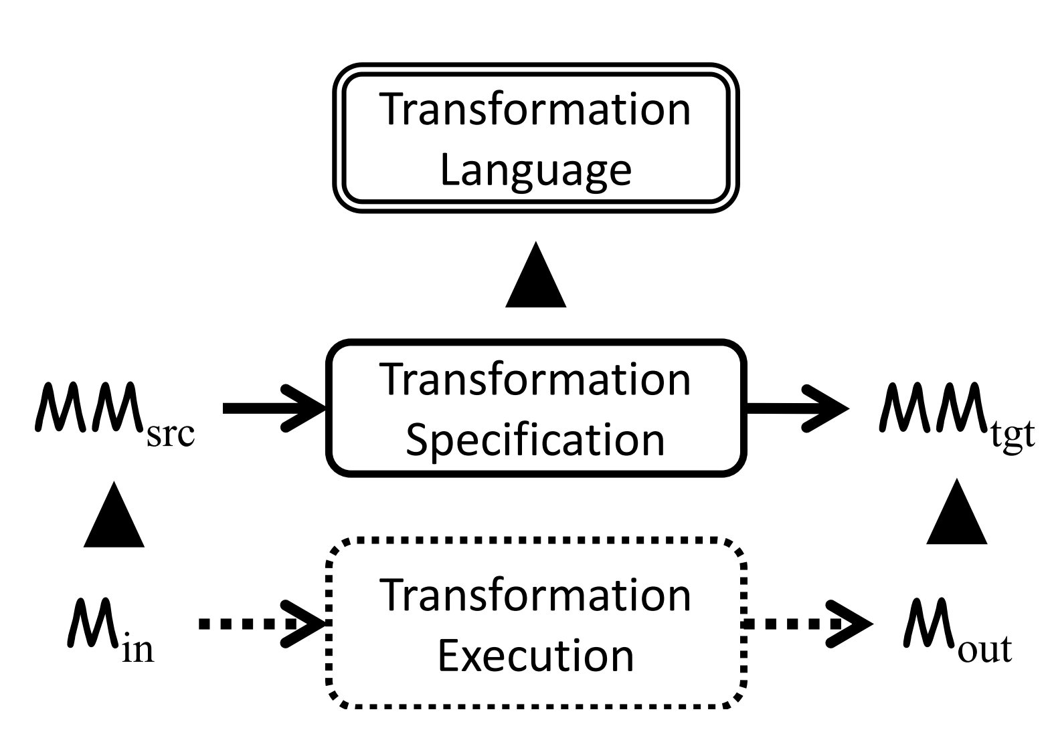


Motivation & Challenges
Model Transformation Background
An insurance that their models behave as expected
e.g. Modellers
MT Designers
Understanding, Tracing, Monitoring, Debugging
What is going on during a Model Transformation (MT) ?
⟹ Model Animation (MA)
Guidelines for DSL testing, debugging, and formal verification
⤍ Model Animation (MA) has received way less attention ☹

Slide 4
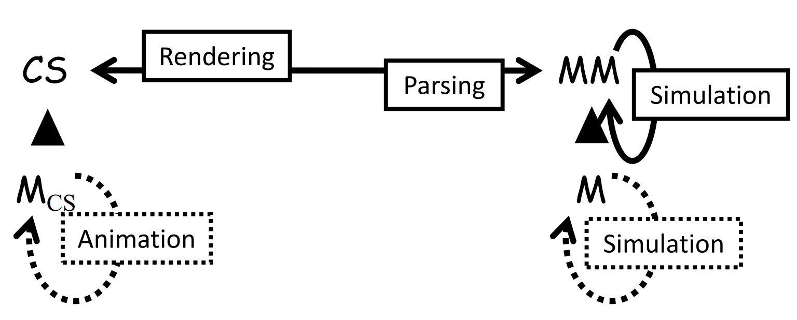
Motivation & Challenges
Confusion Literature
Ensuring
correctness
DSL’s Behaviour
captures
Model Animation (MA)
MA can be seen as the visual representation of the simulation of Model Transformations (MTs)
Animation MA
Tightly Connected
Simulation MT
[Levi Lúcio and al. 14]
Visualisation
Required Components of MA
Concret Syntax (CS) of MM (a.k.a. notation)
Visualize M as graphical Model M_{CS}
Simulation MT (Specification)
Computing steps are visually rendered over M_{CS}

Slide 5
Agenda
Context & Motivation
Work Positioning
Key Ingredients Support to Build Animators
Our Proposal
Conclusion

Slide 6




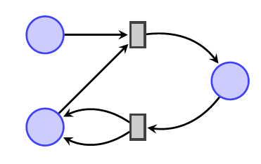

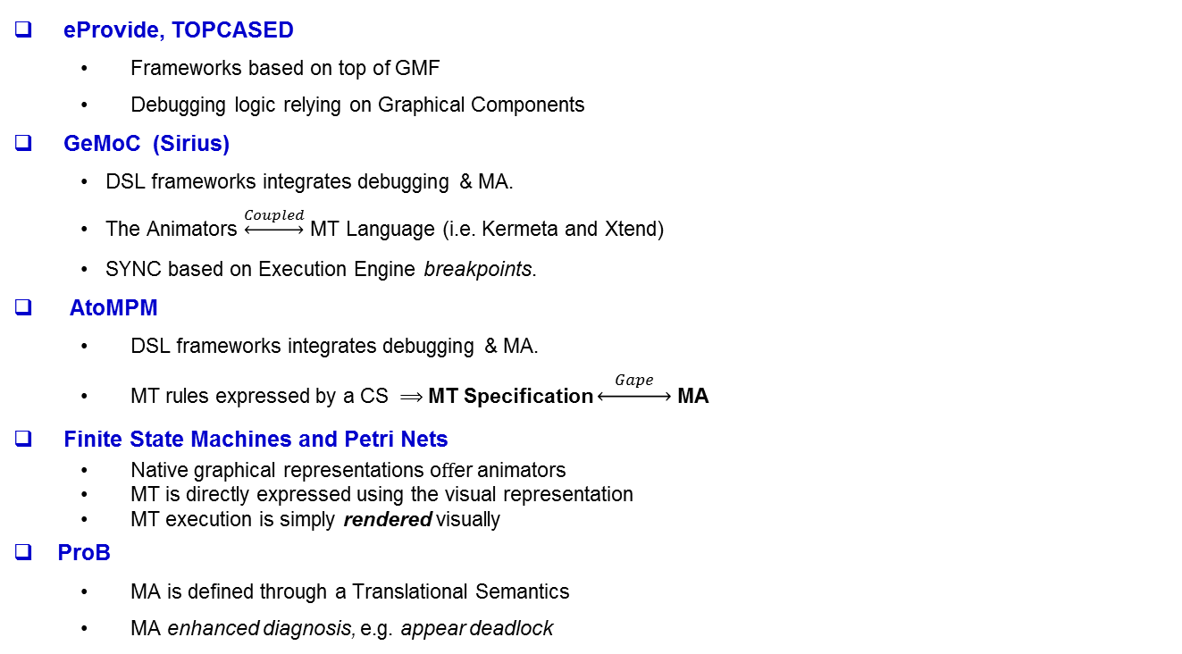
MA Tools
DSL Tools to perform MA alongside of MT
MA Designer
eProvide, TOPCASED
Frameworks based on top of GMF
Debugging logic relying on Graphical Components
GeMoC (Sirius)
DSL frameworks integrates debugging & MA.
The Animators $\underset{↔}{Coupled}$ MT Language (i.e. Kermeta and Xtend)
SYNC based on Execution Engine breakpoints.
AtoMPM
DSL frameworks integrates debugging & MA.
MT rules expressed by a CS ⟹ MT Specification $\underset{↔}{ Gape }$ MA
Finite State Machines and Petri Nets
Native graphical representations oﬀer animators
MT is directly expressed using the visual representation
MT execution is simply rendered visually
ProB
MA is defined through a Translational Semantics
MA enhanced diagnosis, e.g. appear deadlock

Slide 7

Identified Limits
Variety of DSL graphical CS and MT Specification
Mapping AS2CS is hidden and provided as a black-box
Lack ﬂexibility in the MA specification
Formalism not directly manipulate MM’s features
Layout algorithms are not supported
➔ Generalizing a MA is difficult !
In case of hard-coding own MA
Redesigning from scratch is tedious and time consuming
Requiring a good background and maintained by the MA engineer
Lack of MA units across DSLs
MTs are likely specified independently of any MA
MA must match the MT specificities
➔ Gap: MT Engine / MA Engine
Lack ﬂexibility in the MA specification, and reuse of MA units across DSLs

Slide 8
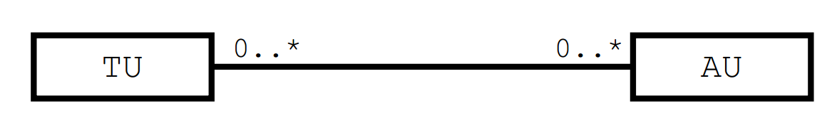
Our Vision
Fully unlock the potential of MA engineering
Multi-abstraction, and Reuse
N:N Mapping: Transformation (TU) and Animation (AU) Units
But what can we benefit ?
UT is is directly mapped to UA
Flexibility: A single UT to be visualized in multiple MA (Taking into account the heterogeneity of MA)
MA expressed as declarative way
Synchronizing Execution Engines of MTL and MA
Connectivity with external tools
Animation
Engine
Notes:
l'idée est de considéré l'unicité de animations et des transformations pour fournir les alternatives

Slide 9
Our Vision
Goal: Towards the Systematic Engineering of Model Animators
Reusable and flexible components for designing MA Tools
Key Challenges:
Explicitly define CS for easily expressing MA;
Build an MA language to express AU in a compositional way,
Explicitly relate MA units with their transformation counterparts
Concrete Syntax
MA Engine
Relationship
possible design primitive combinations
Core
Components
MA
Tools
Model Transformation
MA Specifc-ation

Slide 10
Agenda
Context & Motivation
Work Positioning
Key Ingredients Support to Build Animators
Our Proposal
Conclusion

Slide 11
DSL EXAMPLES

Slide 12
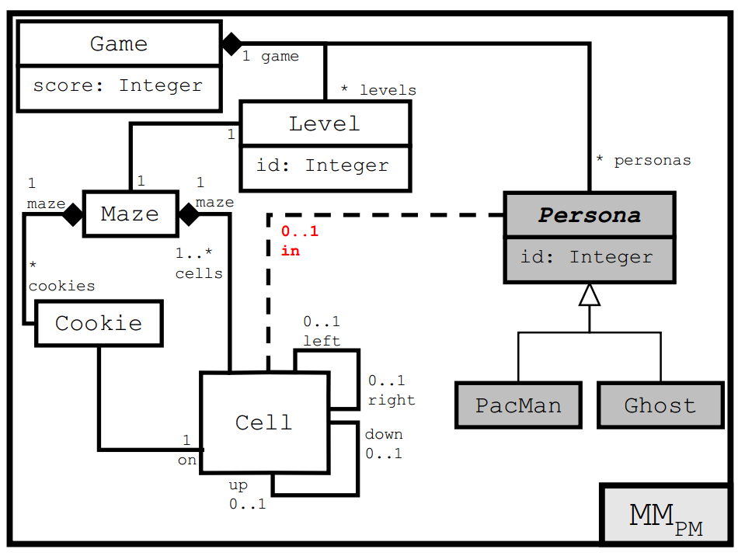
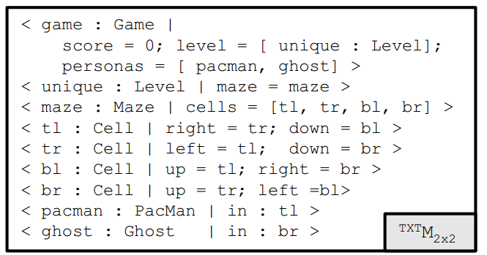
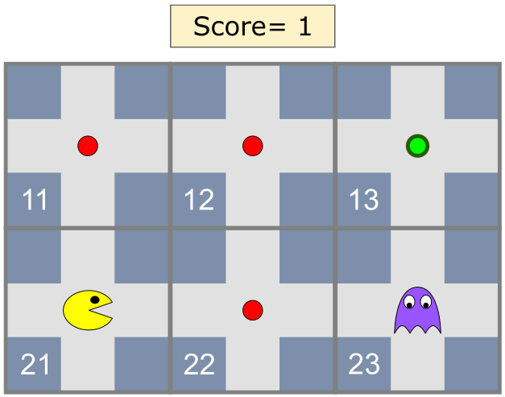
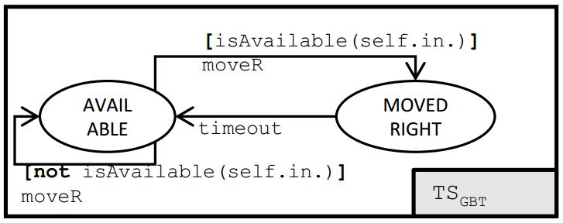
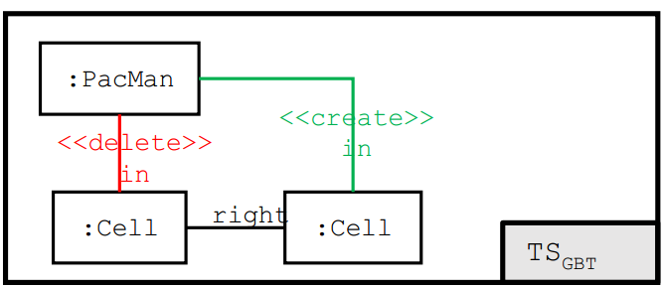
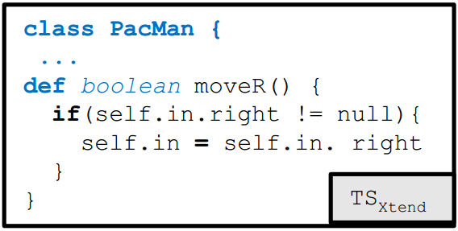
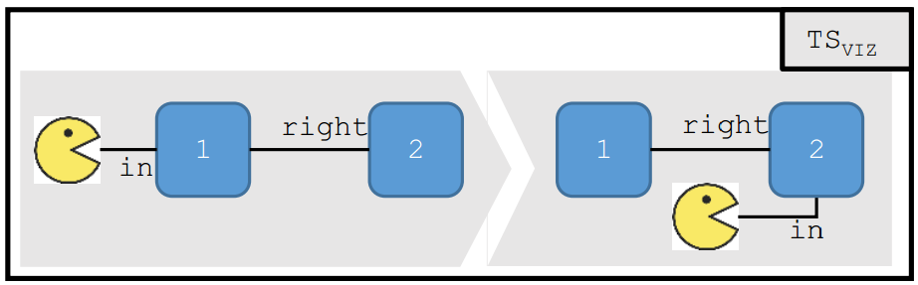
A DSL for the PacMan game
Abstract Syntax as a Metamodel
Concrete Syntaxes
Textual
Visual
Semantics as MT
Graph Rewriting Systems
Meta-Languages

Slide 13
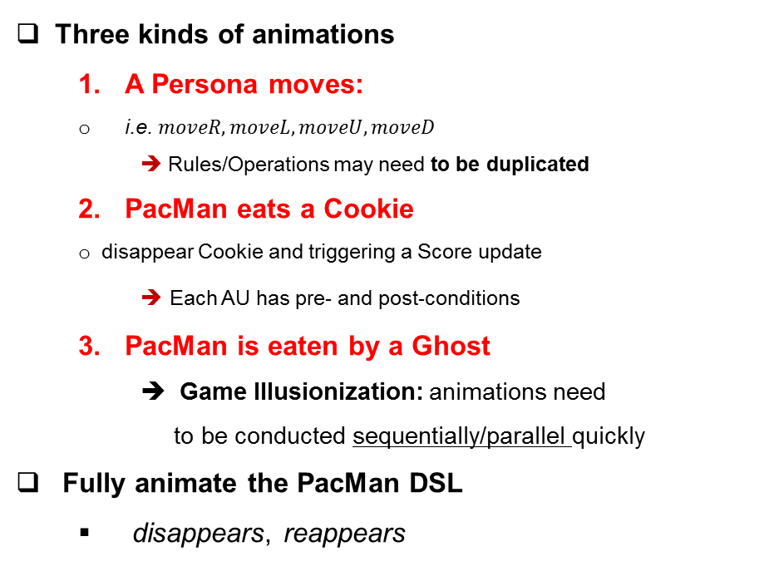
A DSL for the PacMan game
Three kinds of animations
A Persona moves:
i.e. $moveR, moveL, moveU, moveD$
➔ Rules/Operations may need to be duplicated
2. PacMan eats a Cookie
disappear Cookie and triggering a Score update
➔ Each AU has pre- and post-conditions
3. PacMan is eaten by a Ghost
Game Illusionization: animations need
to be conducted sequentially/parallel quickly
Fully animate the PacMan DSL
disappears, reappears

Slide 14
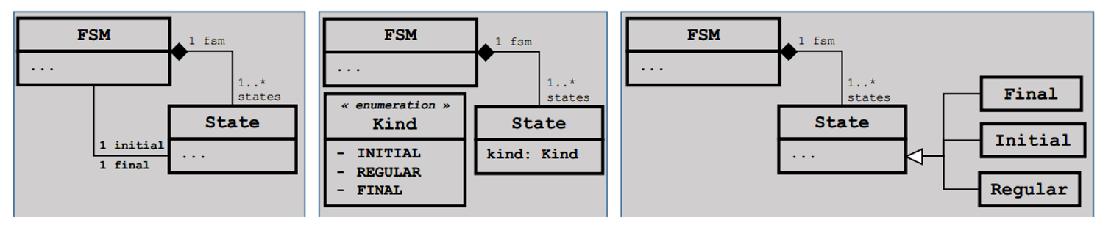
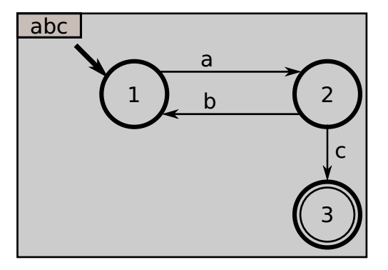
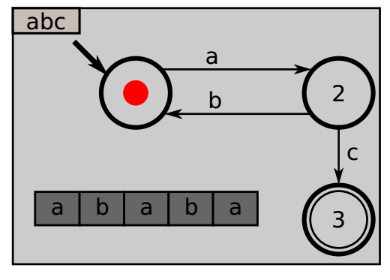
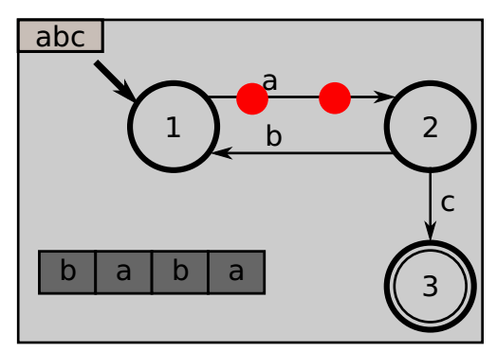
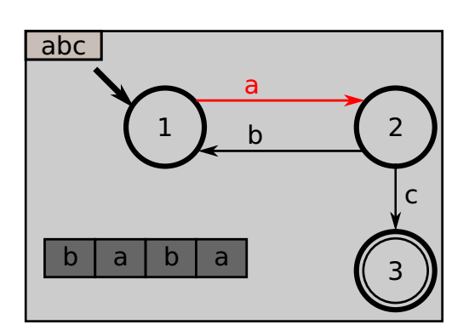
A DSL for Finite-State Machines
FSM: A DSL for Finite-State Machines
Visual Representation
Two categories of Animations
Showing the progression on the word
Showing the FSM’s current state
Alternative representation of MA
State Transition
Variability model animation specification
Sequential
Concurrent
Timed approach

Slide 15
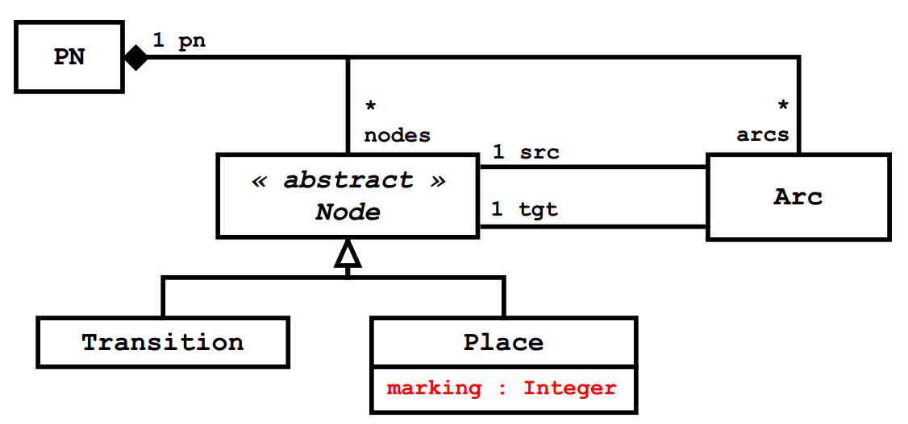
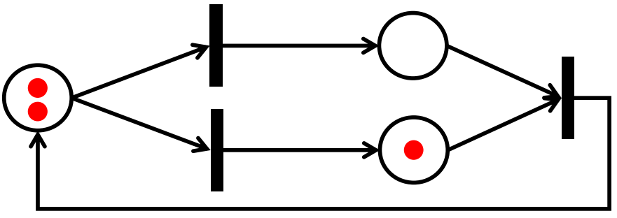
PN: A DSL for Petri Nets
A MM for Place/Transition Petri Nets
Animations PN:
Concrete Syntax: circle, black thin box, directed arrow
UA: Highlight, Removing, creating
Animation CTRL: sequentially
Perform them step by step, or automatically, or even interactively

Slide 16
Challenges
3 Key Challenges to adress:
Explicitly define CS for easily expressing MA;
Build an MA language to express AU in a compositional way,
Explicitly relate MA units with their transformation counterparts

Slide 17
Challenge 1: Concrete Syntax
Bijection Relationship <Visual Concrete Syntax (CS) , DSML’s metamodel MM >
Explicit MT between MM and CS
MM_{CS} must explicitly metamodelled
MM_{CS} must Cover the definition of visual representations
Define the rendering relationship (5 Challenges)
Providing simple visualisation of data structures
Providing complex rendering patterns
Integrating “insideness” natively
Providing “snapping” capabilities
Supporting animations natively
MM_{AS}
MM_{CS}
M
trans
parsing
M_{AS}
rendering
M_{CS}

Slide 18
Challenge 2: Model Animation
Design the MA framework: De-/Reconstruction of MTLs [ Syriani and al. 14]
Complex
Animations
Idea of ﬂexibility and reuse of MA units
Reconstruction
Deconstruction
Possible Design Primitive Combinations
MA Framework
A primitive Combinators
separate
an elements
UA Eﬀects Library
Creation Eﬀects
Basic animation eﬀects
WorkSpace
WorkSpace
Deletion Eﬀects
CTRL 1: Loop
shape
CS components Library
Action Eﬀects
Sequantial
Table
CTRL2: time
Parallel
table
Graphical
Elements
Path Motion
TexBox
combinators outside
Organized and scheduled
C k
Geometric
Combinators m
Element n
delay
Repetitors
//
Embedding
the scheduling inside
the UAs
Complex Animations

Slide 19
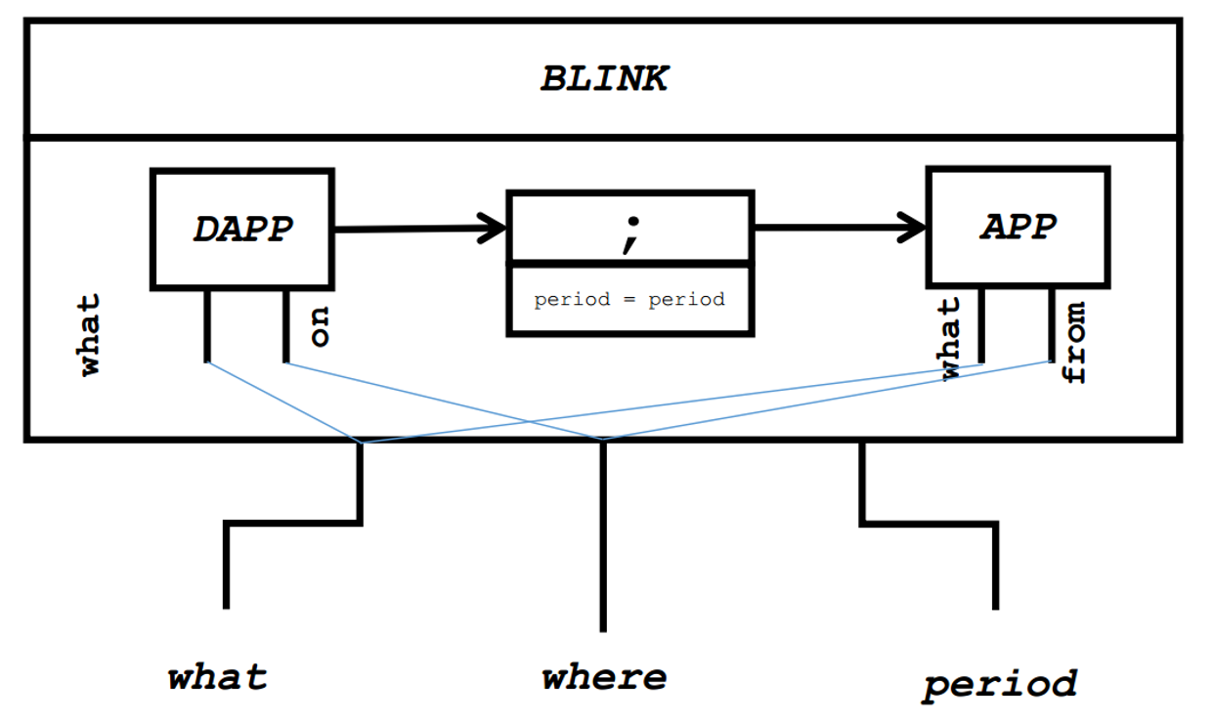
Challenge 3 : Parameterisation of Animation
Possible Param. Values
Possible Param. Values
Parameterisation of Animation
Browsing, customize/extend/modify
Conjoined/Nested Element Block
Mechanism required
Using Model’s Elements
Using the Graphical Elements
Two basic animation units
APP: making an element appear
DAPP: making an element disappear
Complex Unit BLINK = APP ⨁ DAPP
P1 …Pm
P1 …Pm
Define
Composer
UA1
parameter=values
UA2
Attche
what
what
on
on
Notes:
MA est indépendantes de SDL et réutilisable
Extensibilité -> sur plusieurs aspects

Slide 20

Challenge 3 : Linking AUs and TUs
?
How are mapped AUs to specific TUs ?
By Annotation:
Annotating TUs, i.e. @Step annotation
Annotating AUs with TUs $ref
∼ map TUs with debugging [Erwan B., et al. 2018]
By Explicit Map:
Defined outside both the MT and MA Specifications
Transformation Specification
class StateAspect {
@Step
def public void step(String input) {
// Get the valid transitions
…..

Slide 21
Agenda
Context & Motivation
Work Positioning
Key Ingredients Support to Build Animators
Our Proposal
Conclusion

Slide 22
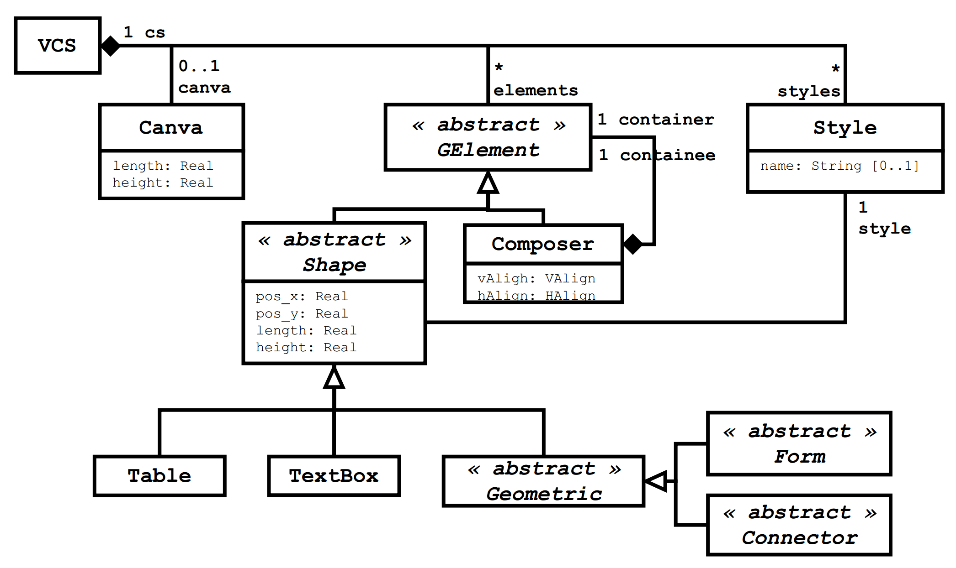
Our Proposal
VCS: A simplified DSL for specifying Visual Concrete Syntaxes

Slide 23
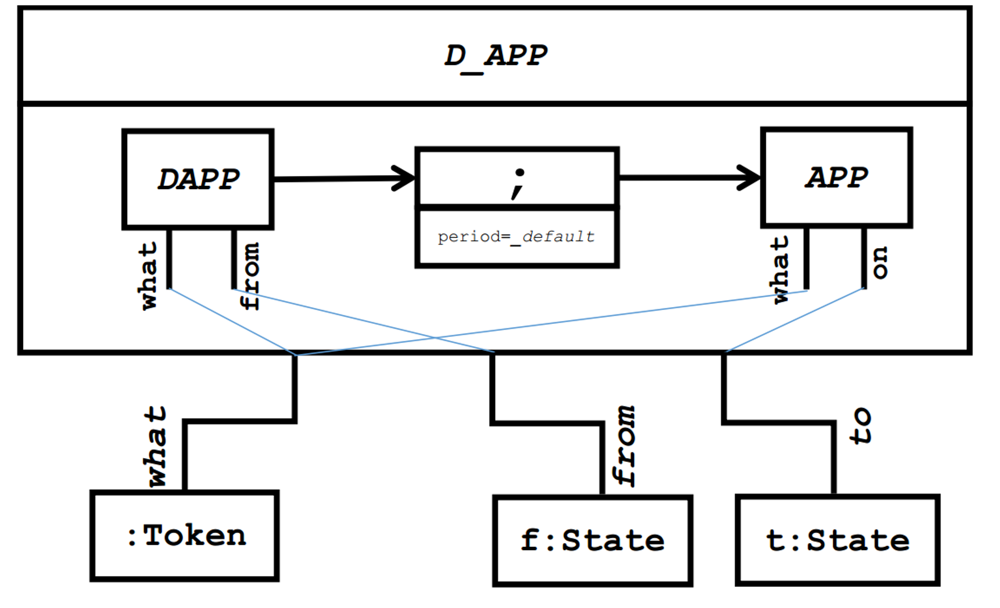
Revisiting the FSM Overview of our proposal with an example for FSM
VCS: A simplified DSL for specifying Visual Concrete Syntaxes

Slide 24
Revisiting the FSM Overview of our proposal with an example for FSM
Transformation Specification
class StateAspect {
@Step
def public void step(String input) {
// Get the valid transitions
…..
MA Framework
Palette Design Primitive
Define Unit Animation
Attach Animations Units to Transformation Units.
Visual Components
+ Insert UA
+ Insert Element
+ Customize Element
+ Get UT
State
Transition
MA Spec.
MT Spec.
UA Eﬀects Library
Disappear
token
Creation Eﬀects
Firing
delay
Deletion Eﬀects
Animation RUN
Connector .
BLINK
Action Eﬀects
delay
Edit UA parameters
Edit Element
getEnabled
-Transition
Reappear
token
delay
token
kind of arrow
Combinators outside
Disappear
Solid
delay
Repetitors
//
3 seconds
Black
Apply
Delete
Cancel
Save
Delete
Cancel
Save

Slide 25
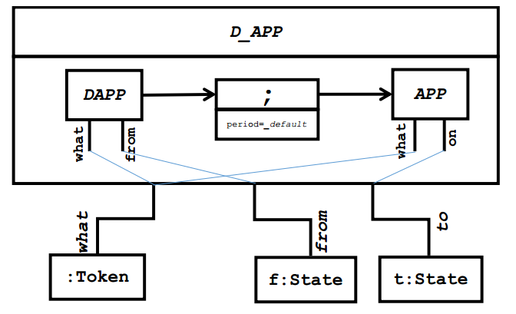
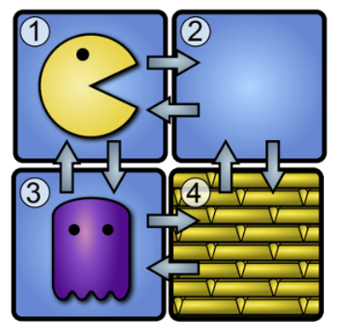
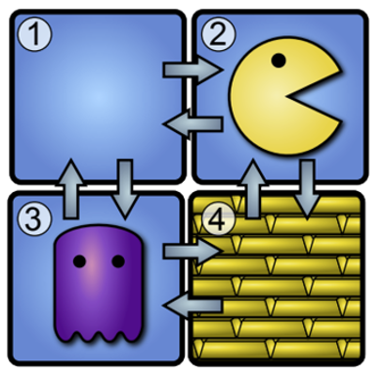
Reuse UA for PacMan
Transformation Specification
class PacMan { ... def boolean moveR() { if(self.in.right != null){ self.in = self.in. Right}
MA Designer
Animation Library
Seeking an animation
Derived UAs
Reuse
CM_{i}
UA_{x}
CM_{i}
CM_{i}
UA_{x}
UA_{x}
Providing an animation
Atomic UAs
CM_{i}
CM_{i}
:Pacman
f: Cell
t: Cell
CM_{i}
UA_{i}
moveR

Slide 26
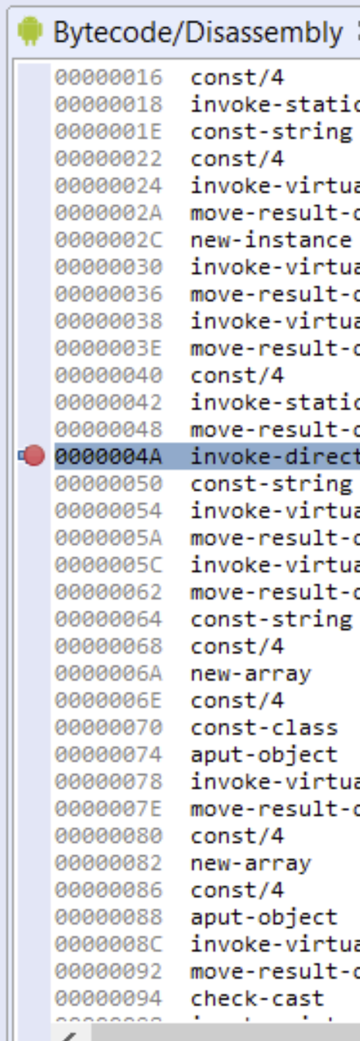
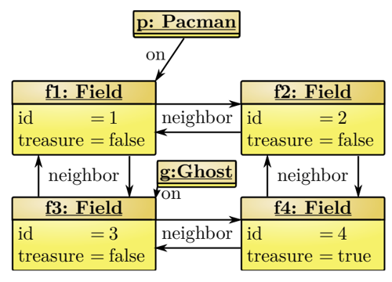
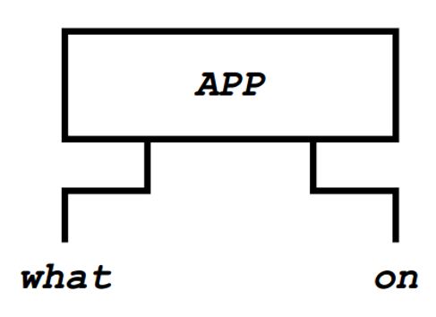
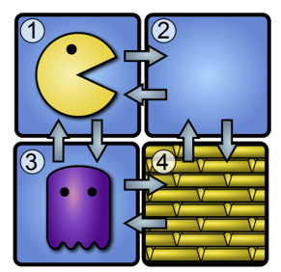
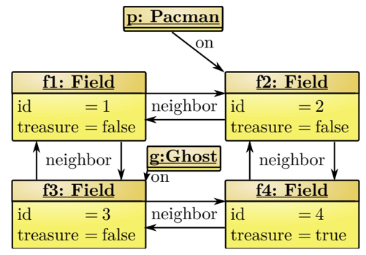
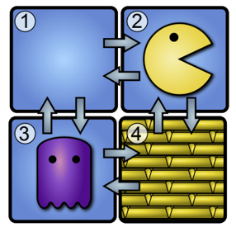
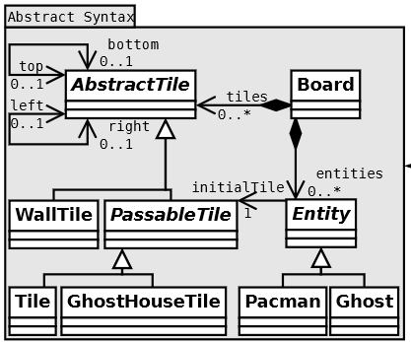
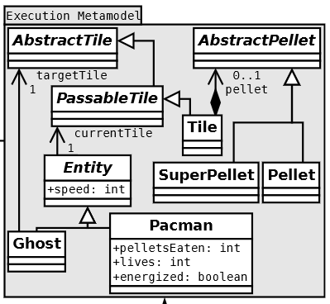
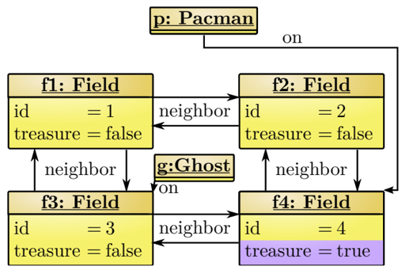
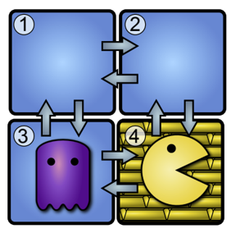
Roadmap Proposal
Execute
Communicate
Synchronize
Render
Map AUs 2TUs Trace code listner Model State UAs front-end
By Annotation:
By Explicit Map:
Breackpoint
Transformation Specification
Breackpoint
class PacMan { ... def boolean moveR() { if(self.in.right != null){ self.in = self.in. Right}
Step 1
animate
Breackpoint
Step 2
animate
merges
Step 3
animate
…
…
…

Slide 27
Agenda
Context & Motivation
Work Positioning
Key Ingredients Support to Build Animators
Our Proposal
Conclusion

Slide 28
Conclusion
Model Animation of Model Transformation in MDE
Lack ﬂexibility in the MA specification, and reuse of MA units across Dsls
First step towards a systematic approach for MA engineering,
Three important challenges.
Designing concrete syntaxes for DSLs,
A compositional approach for defining complex MA,
Linked to appropriate TUs that would drive the MAs.
Our Proposal & Usage Scenario
Future work
Engineering our Proposal
Evaluating the Prototype's Usability
Be Used as an Educational -Aid Tool

Slide 29
Thank you for your attention

